Slide 1
QUEUE DATA STRUCTURE
Presented by : NagaJayaMadhuPraveen
Faculty Advisor : Dr. Victor Govindaswamy

Slide 2
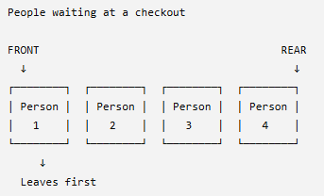
QUEUE DATA STRUCTURE
Main Points
Queue – Introduction
A queue is a linear data structure used to store elements in an ordered manner.
A queue follows the FIFO principle.
FIFO = First In, First Out
The element that enters first is the element that leaves first.
A real-life example is a line of people waiting at a checkout counter.
Real-Life Example:
Main Idea
First person in → First person out

Slide 3
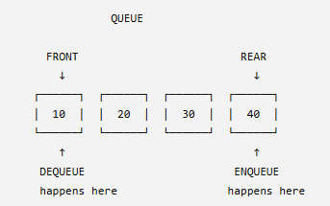
QUEUE OPERATIONS
Main Queue Operations
1. enqueue()
Adds a new element to the rear/end of the queue.
2. dequeue()
Removes an element from the front/start of the queue.
3. isEmpty()
Checks whether the queue contains no elements.
4. isFull()
Checks whether the queue has reached its capacity.
5. displayAll()
Displays all elements currently in the queue.
Important
enqueue → rear
dequeue → front

Slide 4
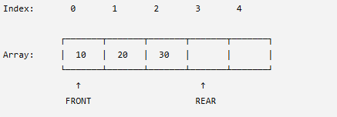
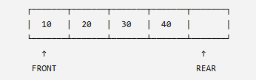
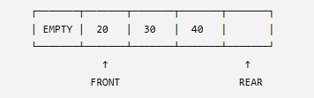
LINEAR ARRAY QUEUE
Queue Using a Static Array
A basic queue can be implemented using a fixed-size array.
Example:
Enqueue
If we add 40:
Dequeue
If we remove 10:
Problem with a Linear Queue
The position containing 10 is now unused.
Even though there is an empty position at the beginning, the rear may eventually reach the end of the array.
This is why circular queues are useful.

Slide 5
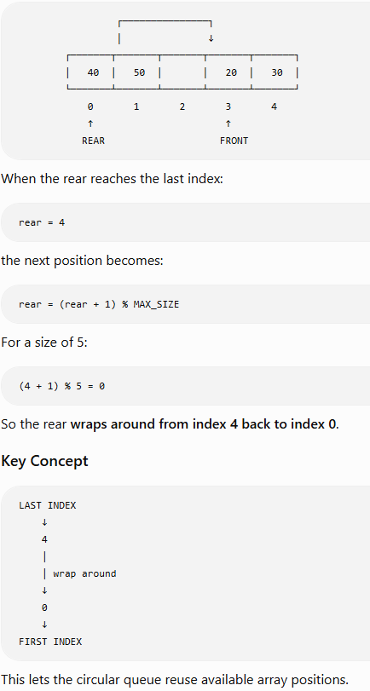
CIRCULAR QUEUE & WRAP-AROUND
Why Circular Queue?
A circular queue treats the array as if the end connects back to the beginning.
This allows previously unused positions to be reused.
Circular Wrap-Around

Slide 6
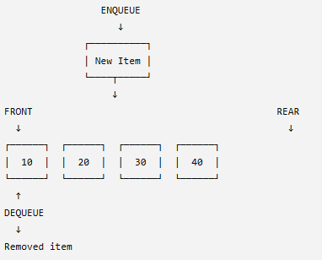
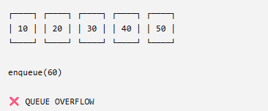
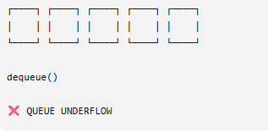
OVERFLOW, UNDERFLOW & ENQUEUE/DEQUEUE
Enqueue → Queue → Dequeue
Queue Overflow
Occurs when we try to enqueue() into a queue that is full.
Occurs when we try to dequeue() from an empty queue.

